Slide 1

Dewolf: Improving Decompilation by leveraging user surveys
Steffen Enders, Eva-Maria C. Behner, Niklas Bergmann, Mariia Rybalka, Elmar Padilla, Er Xue Hui, Henry Low, Nicholas Sim steffen.enders@fkie.fraunhofer.de
2023-03-03 | BAR Workshop, San Diego
Notes:
Self-Introduction
Research collaboration between Fraunhofer FKIE and DSO National Laboratories: Decompilation.
Last talk of today
Everyone knows we need human-readable decompilation output for _manual _malware or binary analysis, right? … right?
Not a lot of recent research
Still, decompilation not solved
Try it out yourself

Slide 2
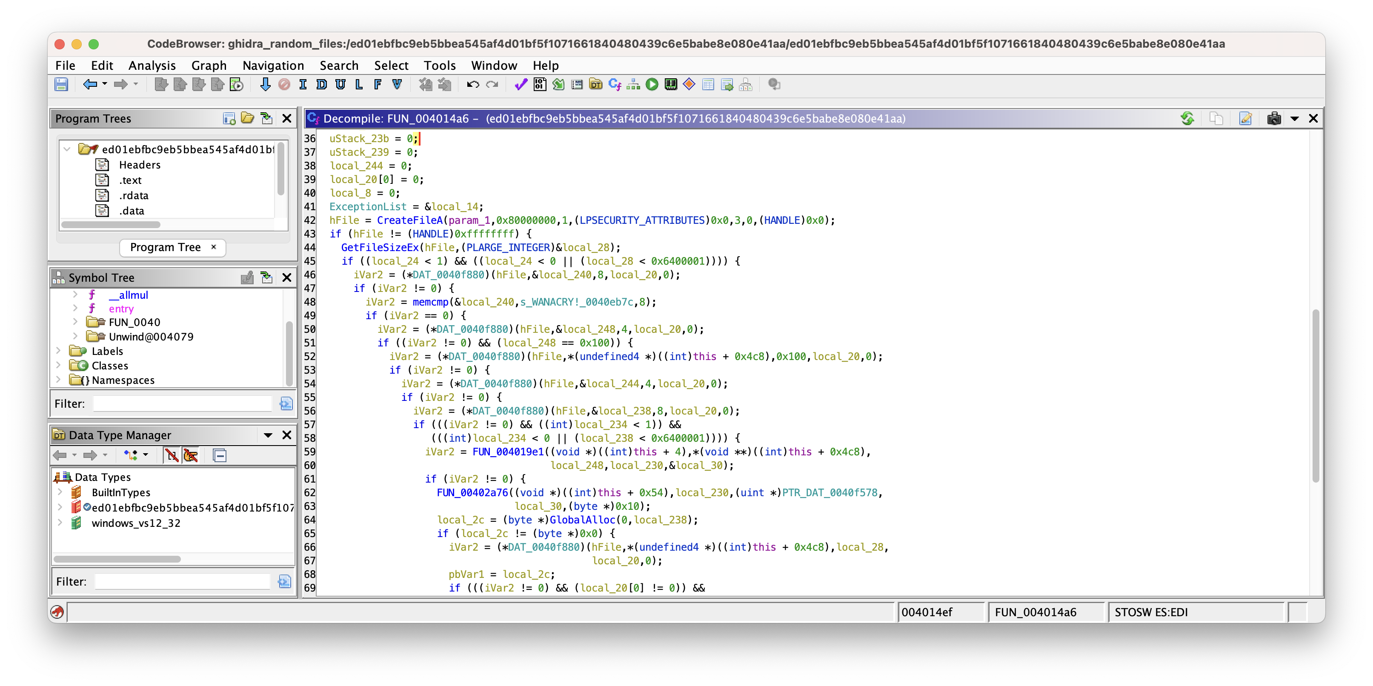
Notes:
SOTA decompilers are great
Lots of room for improvement, especially with malware
Example.
WannaCry Sample.
You want this? I don‘t
Department does a lot of malware analysis
Improve process and tackle decompilation to assist manual analysts

Slide 3


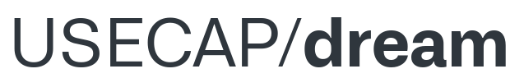




Related Work / Decompilers
Essential for many binary analysis approaches
Each decompiler has a different focus!
There is still plenty of room for improvements!
https://github.com/revng
https://www.qbssoftware.com/jeb-decompiler.html
https://mobile.twitter.com/retdec
https://ghidra-sre.org
https://hex-rays.com
https://github.com/USECAP/dream
https://binary.ninja
Notes:
Take a look at related work and existing decompilers
Many of approaches, publications, and products
Ghidra, Hex-Rays, Binary Ninja
In the past years, not many papers except ML
Not many are focusing on manual analysis
Other fields, e.g. Recompilable Output
Most notable publications about traditional decompilation for manual analysis
DREAM
Revng
We identified DREAM as base for our research
What does focusing on Readability mean?

Slide 4
Decompilation can be done differently!
Output 1
Output 2
undefined4 dividability_rules(void) {
int iVar1; int local_10 [3];
printf("Enter a number: ");
__isoc99_scanf(&DAT_0804c025,local_10);
iVar1 = local_10[0];
printf("A number is dividable by %d:\n",local_10[0]);
if (local_10[0] == 0x7d) {
printf("last three digits dividable by 125",iVar1);
return 0; }
if (local_10[0] < 0x7e) {
if (local_10[0] < 0xb) {
switch(local_10[0]) {
case 0:
printf("not possible",iVar1);
return 0;
...
case 10:
printf("last digit is 0",iVar1);
return 0;
}
} else {
if (local_10[0] == 100) {
printf("the last two digits are 0",iVar1);
return 0;
}}}
printf("we have no rule",iVar1); return 0; }
int dividability_rules() {
int var_0; int * var_1;
printf("Enter a number: ");
var_1 = &var_0;
__isoc99_scanf("%d", var_1);
printf("A number is dividable by %d:\n", var_0);
switch(var_0) {
case 0x0:
printf("not possible");
break;
...
case 0xa:
printf("last digit is 0");
break;
case 100:
printf("the last two digits are 0");
break;
case 125:
printf("last three digits dividable by 125");
break;
default:
printf("we have no rule");
}
return 0;
}
Notes:
Output differs on focus!
For example, dividability function
Left: more low-level + follows the semantics dictated by assembly.
Right: more higher-level and abstracted
Depending on the usecase either of those outputs may be favoured over the other.
For manual analysis, the right seems to be better
Department has background in malware analysis
We believe that manual analysis is main application
We set out focus on manual analysis

Slide 5
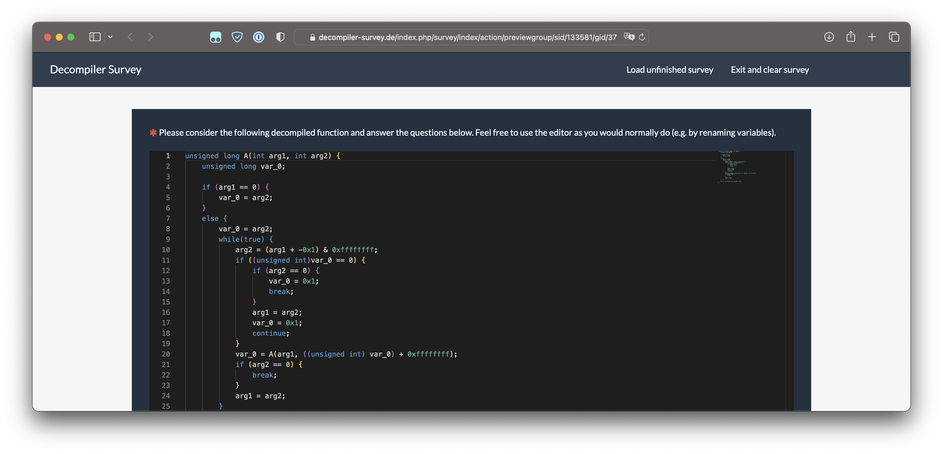
User Surveys
Notes:
How to assess readability?
Optimizing for human analysis, involve human analysts!
Other approaches use code metrics
We don‘t think that code metrics can be easily used to assess readbility
We opted for user surveys

Slide 6

User Surveys Metadata
Notes:
We did three user surveys
Not easy to recruit participants, still happy with numbers
We wanted to leverage on domain knowledge of professional reversers.
Also: ultimate goal is to lower the complexity
also Include people without reversing knowledge
survey 1 to assess current SOTA and limitations
Then implemented improvements and evaluated them in survey 2+3
Lets take a short look at what we did in survey 1

Slide 7
User Survey 1
Research Questions:
What decompilation aspects should be improved to enhance manual analysis?
What readability aspects are important to users?
What are the limitations of current approaches and the state-of-the-art?
Notes:
Research questions
We used DREAM, Ghidra and Hex-Rays
Presented users with decompiler outputs
Collected data with comprehensive questions
And asked many questions about preferences and readability aspects

Slide 8
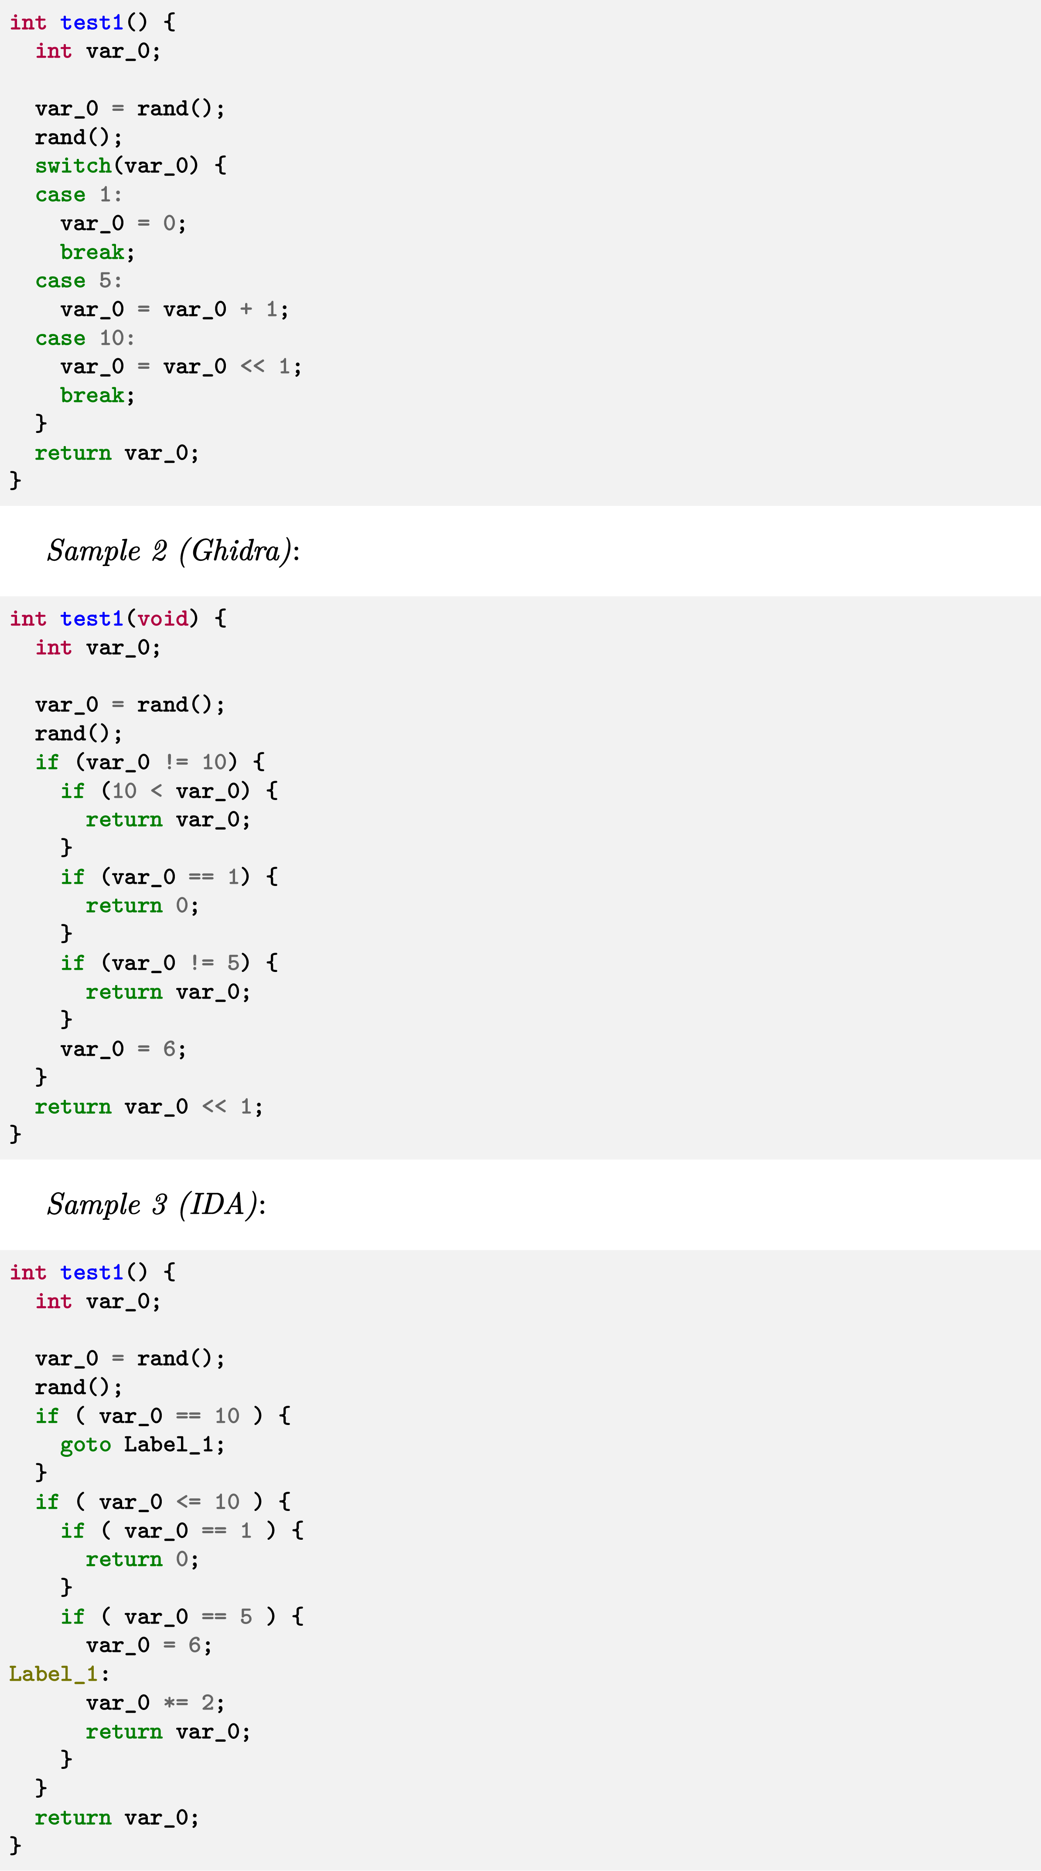
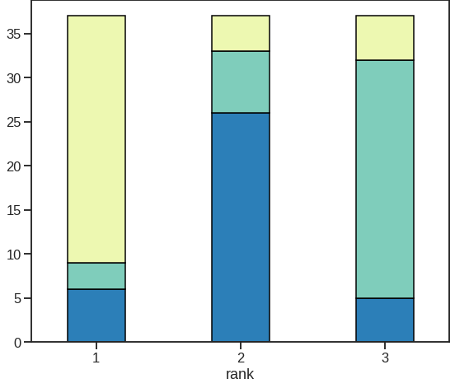
Example 1
Respondents liked switch
They didn‘t like the goto
Notes:
This is one example from survey 1
Restructuring Preferences among Respondants
Given function was restructured differently by different decompilers.
On the left switch, middle if-else, right if-else and goto
Respondents preferred switch, didnt like the goto

Slide 9
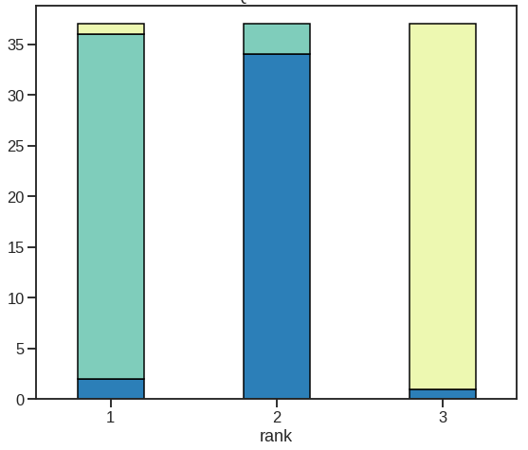
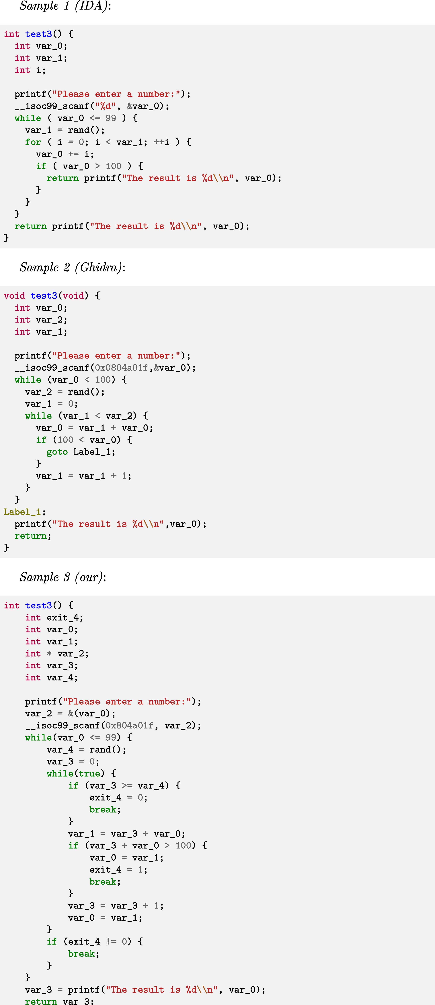
Example 2
+ Short & Clean + For-Loop
- Long & Complex - Too many Veriables
Notes:
Another example that was restructured as Multiple exit region by dream
Left multi-exit
Middle goto
Right no goto
Participants preferred goto over multi-exit
Still, no goto even better.

Slide 10
Survey 1 TL;DR
Readability depends on user preference and the given analysis task
Users crave configurable decompilers
Readability > Assembly Structure
Identified many aspects with room for improvements
Instruction Idioms, Switch Reconstruction, …
Notes:
Current decompilers far from optimal
Especially DREAM with lots of room for improvements
One main result is that users want configurability
Also, readable code seems to be more important than following assembly structure
Also Helped us identify areas for improvements
Unfortunately, DREAM prototype wasnt working anymore
Ended up re-implementing DREAM on top of binary ninja
Then implemented improvements as identified in survey 1

Slide 11

Contributions
Various improvements for DREAM to get academia “back on track” with commercial state-of-the-art decompilers
dewolf Decompiler
highly configurable, easily expandable, and open-source
Available in Binary Ninja’s Plugin Manager and on dogbolt.org
We publish all survey results [1]
[1] https://github.com/steffenenders/dewolf-surveys
Notes:
This leads us to our main contribution.
First, introduce a new decompilation approach that incorporates the identified improvements into DREAM
This includes many small-scale and some substantial improvements
a level that is comparable to other state-of-the-art decompilers.
We also publish a prototype implementation of our approach: dewolf
To allow future research, we made it highly configurable and expandably.
It is available open-source on Github, via the plugin manager of Binja and on dogbolt
Finally, we publish all survey results.

Slide 12
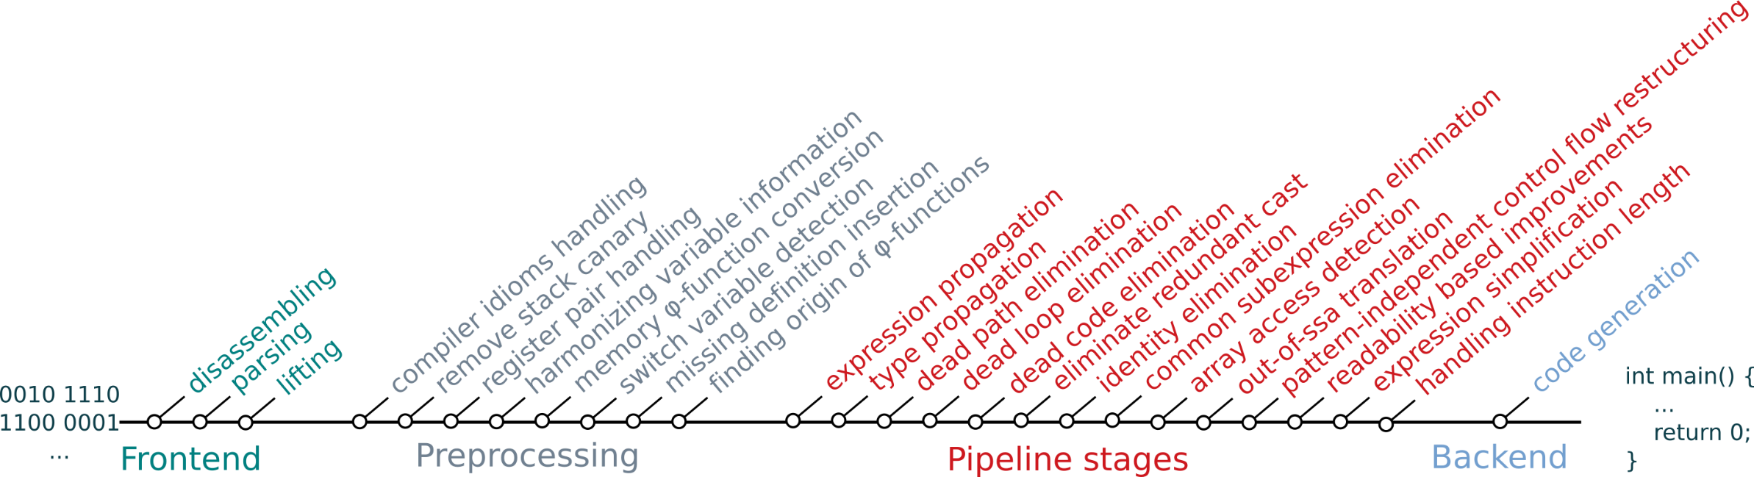
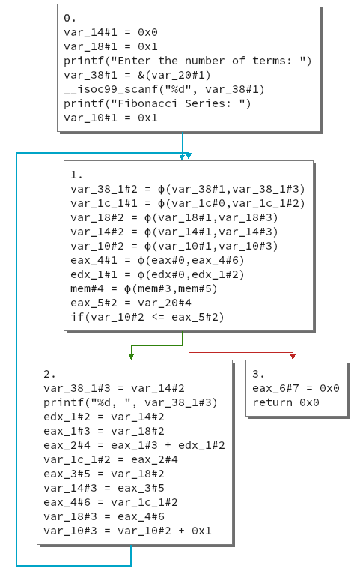
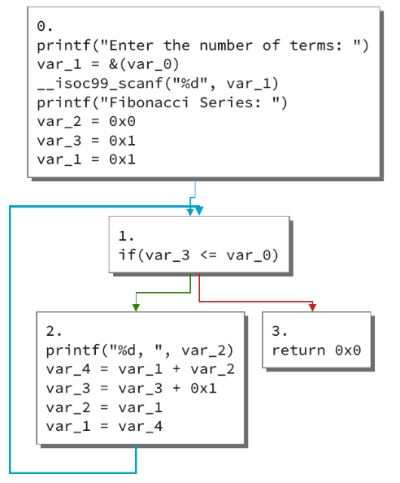
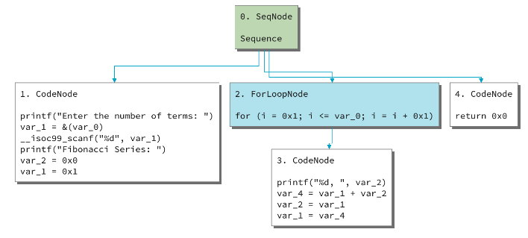

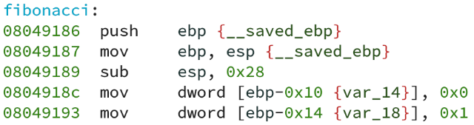
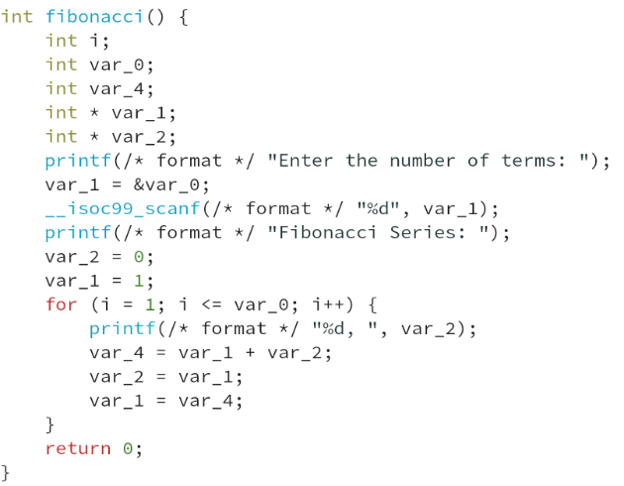
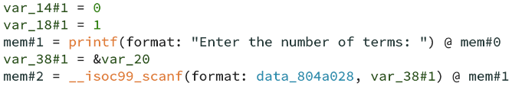

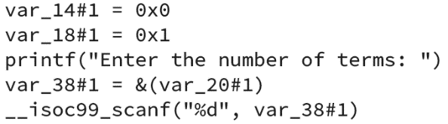
dewolf Overview
Frontend
(Preprocessing/) Pipeline Stages
Backend
0010 1110
1100 0001
Dataflow
algorithms
Control-flow
algorithms
Code Generator
Lifting
Notes:
Lets take a short look at dewolf.
Similar to the universal decompilation machine proposed by cifuentes, we have three phases.
Frontend:
Disassembling etc. done by Binja
We base dewolf on MLIL
Lift to our own IL to allow change of Frontend
Pipeline
Dataflow- and controlflow algorithms
Mostly Independent from each other
You can easily remove/add new stages
You can change their order.
Backend
Currently produces pseudo-c code

Slide 13
dewolf Improvements over DREAM
+
+
=
Switch Variable Detection Subexpression Elimination Constant Representation For-loop Recovery Instruction Idiom Handling Array Access Detection Elimination of Dead Paths and Loops Elimination of Redundant Casts Continue in Loops Custom Logic Engine Improved Out-of-SSA
int64_t xor(int64_t arg1, int64_t arg2, int64_t arg3, int64_t arg4) {
printf("%lu",arg2);
int32_t var_c = 0x0L;
while(true) {
int64_t rax_14 = var_c /* sx None */;
if ((arg2 <= var_c /* sx None */)) {
break;
}
char* rax_4 = (arg1 + var_c /* sx None */);
uint64_t rsi_1 = *rax_4 /* zx char */ /* zx uint32_t */;
int64_t rax_6 = var_c /* sx None */;
int64_t rdx_1 = 0x0L;
char* rax_9 = (arg3 + ((rdx_1:rax_6) % arg4));
uint64_t rcx = *rax_9 /* zx char */ /* zx uint32_t */;
int64_t rax_12 = (arg1 + var_c /* sx None */);
uint64_t rdx_4 = (rsi_1.esi ^ rcx.ecx) /* zx None */;
*rax_12 = rdx_4.dl;
int32_t var_c = (var_c + 0x1L);
}
return rax_14;
}
long xor(void * arg1, long arg2, long arg3, long arg4) {
int i;
int var_1;
void * var_0;
printf(/* format */ "%lu\n", arg2);
for (i = 0; arg2 > i; i++) {
var_0 = arg1 + i;
*var_0 = *var_0 ^ *(arg3 + (i + (0L << 0x40)) % arg4);
}
var_1 = i;
return var_1;
}
vs.
Notes:
As already said, dewolf integrates a lot of improvements over DREAM
Just to give a glimpe of the impact for one function
You can see that the output is much cleaner
Easier to analyze
Faster to comprehend
Of course this does not apply to all functions
Just to those that are affected by the implemented improvements

Slide 14
User Survey 2+3 Research Questions
Research Questions:
Does dewolf produce readable & comprehensible output to qualify as a base for future research?
(Can dewolf exceed state-of-the-art decompilers in certain cases?)
To what extent do respondents tolerate diverging from the assembly during decompilation?
What are further areas to improve readability in future research?
Notes:
In the following surveys
We wanted to ensure dewolfs comprehensibility and that it qualifies as base for new research
For this
not too far from SOTA decompilers
Be able to exceed them in certain cases
Additionally, for future research
Further investigated the participants acceptance of diverging from assembly
Identification of additional areas to improve decompilation

Slide 15
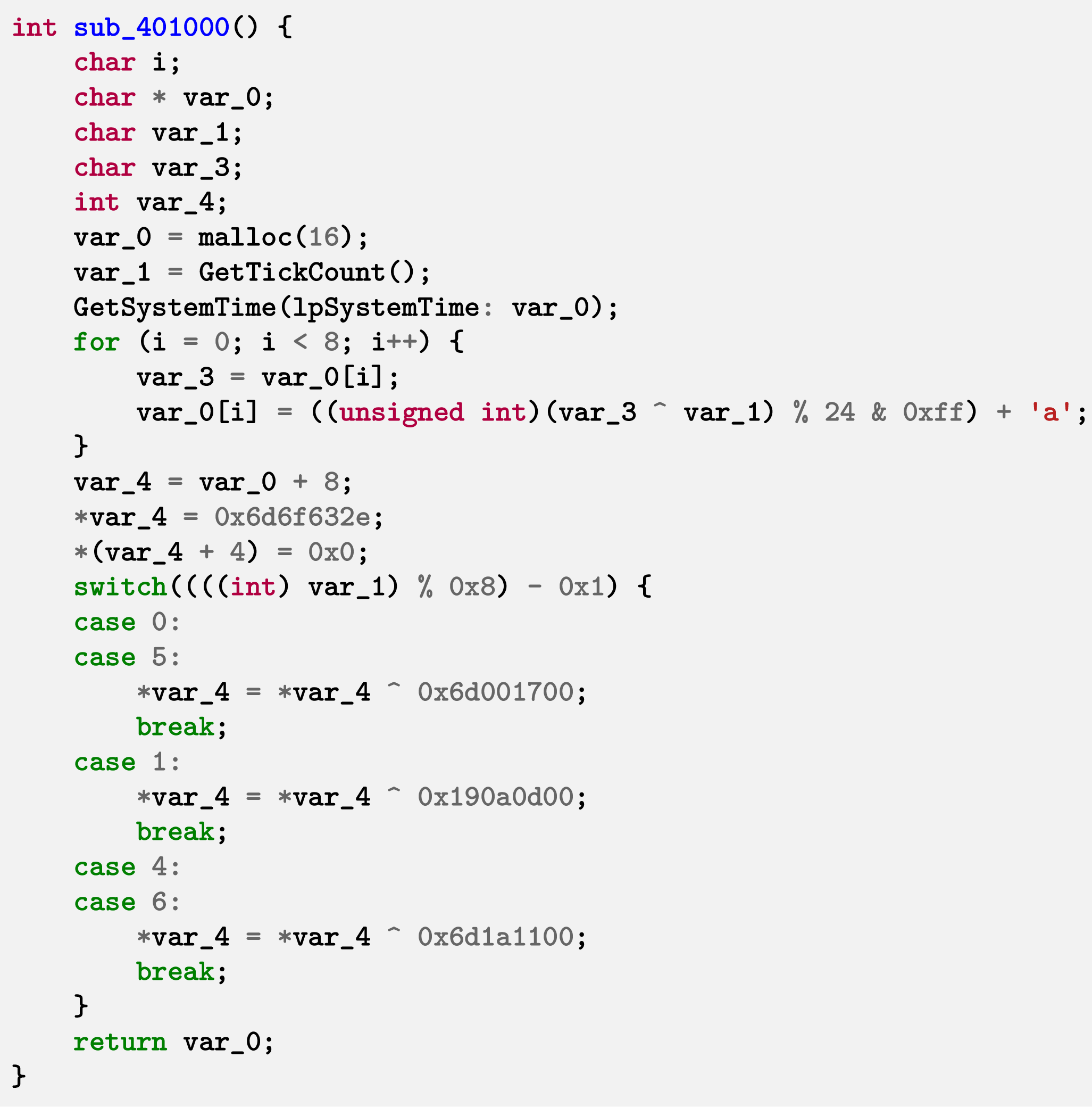
Comprehension Questions
What is the purpose of the function?
What TLDs does the DGA utilize?
What is the most used TLD?
Which of the provided domains could be generated by the DGA?
How many different domains can be generated by the DGA?
Notes:
To ensure comprehensability
We provided the participants with an artifical DGA
Asked questions about the decompiler output
For example, we startet with “What does the function do“
Then explained it to everyone
And continued with more detailed questions

Slide 16
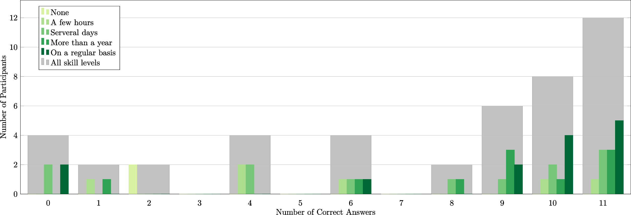
Comprehension Results Divided by C-Skills (self assessment)
Notes:
For every correct answer, each respondant received one point.
Most of them scored a 9 or higher
Unsurprisingly, people with less C-skill had issues with those questions
We also had a few participants with 0-2 points that rushed the survey

Slide 17
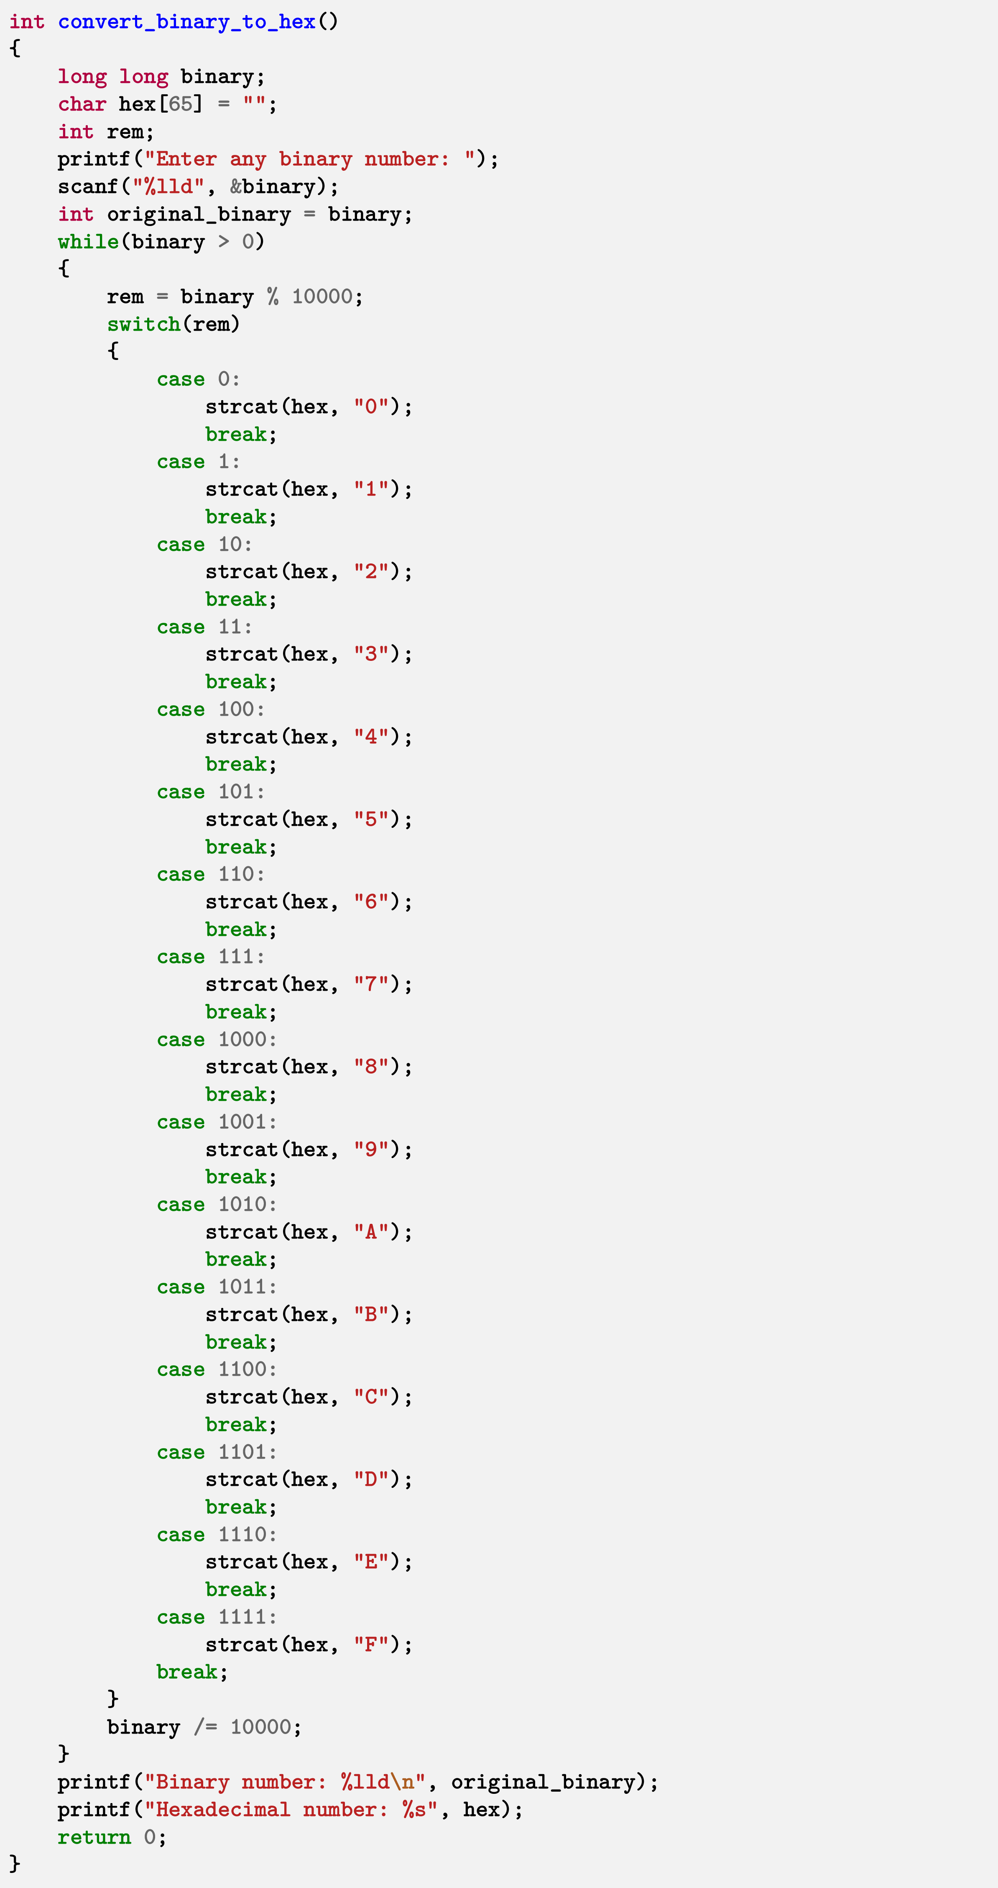



Decompiler Comparison
…
Notes:
To show that dewolf is comparable to Ghidra and Hex-Rays
We crafted a function with various decompilation aspects
Some of them were addressed by our improvements
For this given case, dewolf scored higher than the other two
That indicates that dewolf output qualifies to evaluate benefits from new research

Slide 18
What participants (dis)liked in state-of-the-art decompilers
Positive
Switch-Recovery
Low Nesting Depth
for-loops, if possible
Good Type Recovery
Less Casts
Array Access Detection
Constant Annotations
Negative
Deeply Nested If/Else
High Nesting Depth
While-loops instead of for-loops
Bad Type Recovery
Explicit Casts
Too many unnecessary variables
String Parameters
vs.
Notes:
While many of the aspects covered by dewolf were mentioned positively
Users also had a lot of negative feedback for all three decompilers
For instance, regarding reability, they dont like too many casts in their output (even if needed for recompilablility)
Dont want to go into detail here

Slide 19
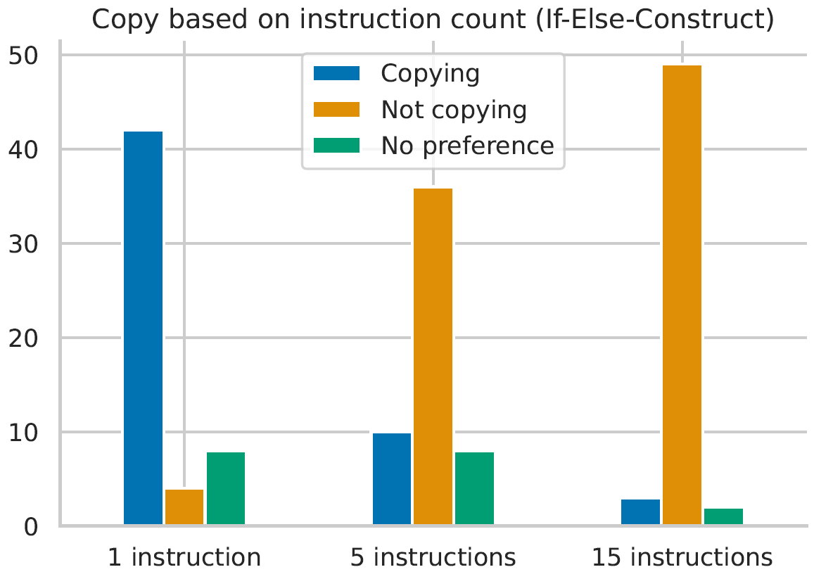
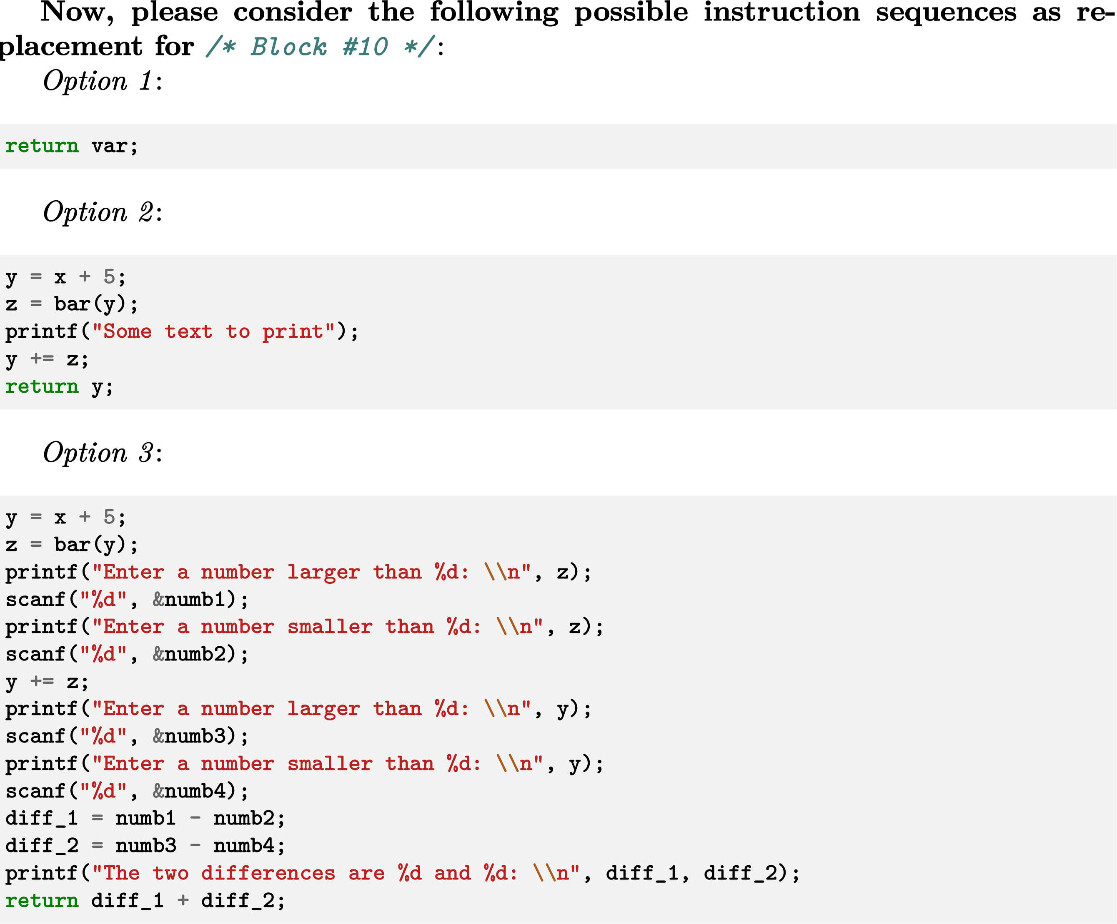
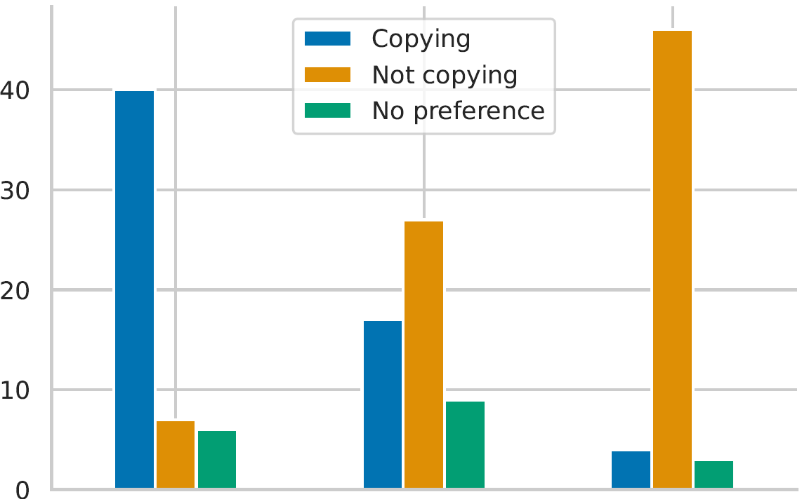
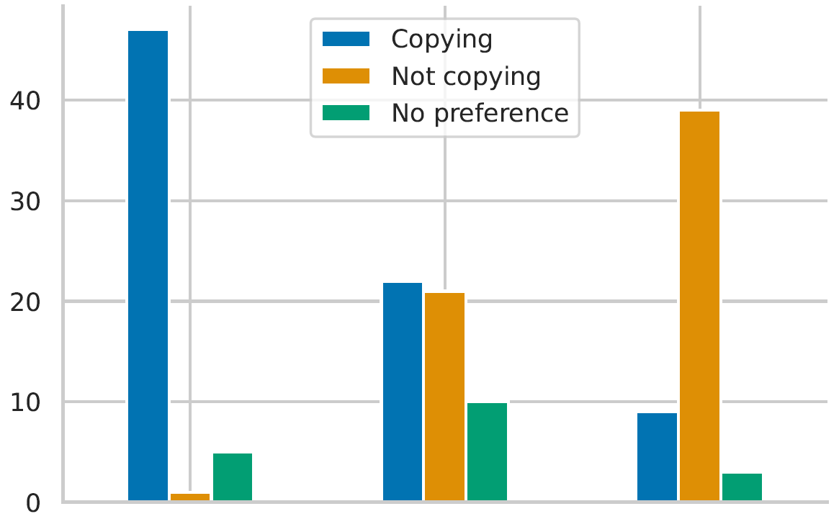
Introducing Copies during Restructuring?
If-Else
?
Multi-Exit
5 Instructions
10 Instructions
15 Instructions
Multi-Entry
5 Instructions
10 Instructions
15 Instructions
Notes:
Finally, we confronted the participants with different restructuring options
Wanted to find out the size of copied codeblocks tolerated when improving the structure
As expected, copying one line is mostly okay.
Copying 5 lines was tolerated when significantly improving the structure
Copying 15 lines was almost never tolerated
This was not the only aspect we evaluated
In the full survey results available online there are many more

Slide 20

TL;DR
Future decompilers (focusing on manual analysis) should:
Favor readability over sticking to the assembly
Be highly configurable!
If you are into decompilation, you should:
Check out dewolf (great base for new research, imho)
Read the paper and survey results
Notes:
Two things that I want you take home is
That according to our survey results
Future decompilers should
Favor readability over assembly
Be highly configurable
Take a look at dewolf, the paper, and the survey results!
We hope that the survey results may spark some new exciting research about alternative decompilation approaches

Slide 21



steffen.enders@fkie.fraunhofer.de
@steffenenders_
Q&A
https://github.com/fkie-cad/dewolf
Notes:
We always love to get your feedback
Get in touch with me for comments etc.
So feel free to write me an email, or dm me at Twitter.
Thank you for your attention.

